Slide 1

Amazon S3 Masterclass
Cloud Object Storage in AWS
Presented by: Naseroddin Baba Date: March 11, 2026

Slide 2

Introduction to Amazon S3
Amazon S3 (Simple Storage Service) is a foundational AWS service that provides developers and IT teams with secure, durable, and highly-scalable object storage.
Scalability: Store and retrieve any amount of data.
Availability: Accessible from anywhere on the web.
Use Cases: Backup & recovery, data lakes, cloud-native apps, and static websites.

Slide 3





What is Amazon S3?
Object Storage
Unlimited Data
High Durability
Unlike file or block storage, S3 manages data as objects. Each object includes the data itself, some metadata, and a unique identifier.
There is no limit to the amount of data you can store. Individual objects can range from 0 bytes to 5 terabytes.
Designed for 99.999999999% (11 9's) of durability, ensuring your data is protected against hardware failure.

Slide 4
What is an S3 Bucket?
A bucket is a fundamental container for objects stored in Amazon S3. Think of it as a root folder in the cloud.
Globally Unique: Bucket names must be unique across all AWS accounts globally.
Region Specific: You specify the AWS Region where the bucket resides.
Examples: my-travel-photos-2024, company-backup-bucket-v1.

Slide 5





S3 Storage Concepts
Bucket
Object
Metadata
The top-level container that holds all your objects. It defines the region and access rules.
The actual file you upload (e.g., photo, video, PDF). It is stored with a unique key (name).
Additional info about the file (e.g., date created, content type, owner info).

Slide 6
Key Features of Amazon S3
Scalability: Automatically scales to meet your needs.
Security: Granular access controls and encryption.
Durability: 11 9's of durability.
Flexible Classes: Optimize costs with different storage tiers.
Availability: 99.99% availability over a year.
Event Notifications: Trigger AWS Lambda functions when data changes.

Slide 7
Object Versioning
Versioning allows you to keep multiple variants of an object in the same bucket.
Recover Accidental Deletes: Easily restore a previous version.
Protect Overwrites: New uploads create a new version instead of replacing the old one.
State: Can be Enabled, Suspended, or Disabled.

Slide 8
Block Public Access
OFF
By default, AWS blocks all public access to S3 buckets. This is a crucial security layer to prevent data leaks.
Public access is blocked at the Account or Bucket level. You must explicitly disable these blocks if you intend to host a public website or share files publicly.

Slide 9
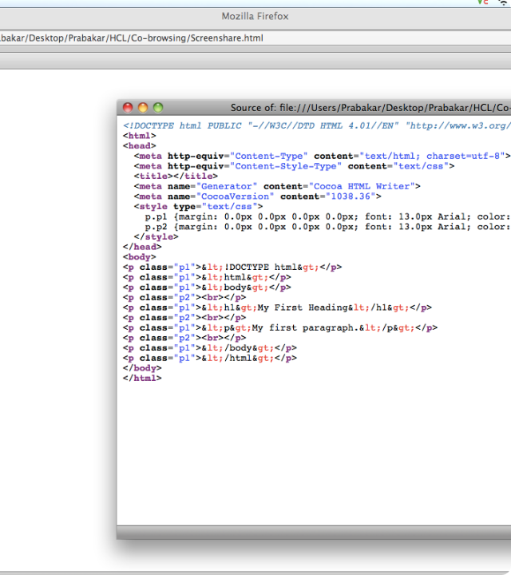
Static Website Hosting
S3 can host static websites (HTML, CSS, JS) without managing a server. It provides a unique endpoint for your visitors.
No Servers: No OS to patch or scale.
Cost Effective: Pay only for storage and bandwidth.
Integration: Works perfectly with Amazon CloudFront for global delivery.

Slide 10

S3 Storage Classes
Optimizing for performance, durability, and cost.

Slide 11

S3 Standard
Frequency: Frequent
The default storage class for frequently accessed data.
Low Latency: High throughput for rapid access.
Use Case: Website images, mobile apps, gaming assets, and active data analytics.
Availability: 99.99% per year.

Slide 12
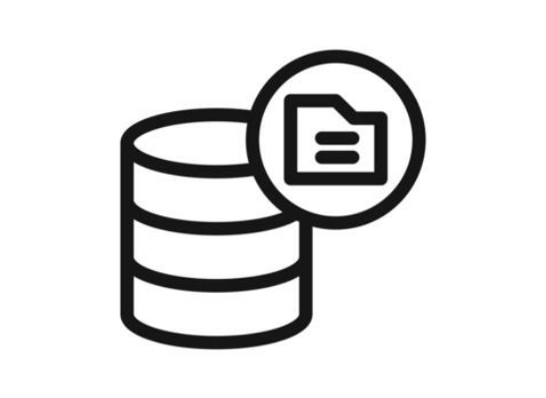
S3 Standard-IA
Frequency: Infrequent
Designed for data that is accessed less often but requires rapid access when needed.
Lower Cost: Cheaper storage price than Standard.
Retrieval Fee: You pay a small fee per GB retrieved.
Use Case: Disaster recovery, long-term backups.

Slide 13
S3 Glacier Retrieval
Frequency: Archival
A low-cost storage class for data archiving.
Expedited: 1–5 minutes retrieval.
Standard: 3–5 hours retrieval.
Bulk: 5–12 hours retrieval (cheapest).

Slide 14
S3 Glacier Deep Archive
Frequency: Once a year
The lowest-cost storage class in AWS for long-term retention.
Ultra Low Cost: Cheaper than on-premises tape storage.
Retrieval Time: 12 to 48 hours.
Use Case: Compliance data, regulatory archives, library media storage.

Slide 15
Lifecycle Policies
Automate your data management to reduce costs over time.
Day 0
Day 30
Day 90
Day 365+
Upload to S3 Standard
Transition to Standard-IA
Transition to Glacier
Permanently Delete

Slide 16





Security in Amazon S3
IAM Policies
Bucket Policies
Encryption
Applied to Users or Roles to define what S3 actions they can perform.
Applied directly to the Bucket to define who has access.
Encrypt data at rest and in transit to ensure privacy.

Slide 17

Bucket Policy
A Bucket Policy is a resource-based policy written in JSON format.
Scope: Specific to the bucket it's attached to.
Power: Can grant or deny cross-account access.
Logic: Always "Deny" takes precedence over "Allow".

Slide 18
IAM Policy
IAM Policies are attached to users, groups, or roles. They define "Who" can do "What".
Centralized: Manage permissions for users across all AWS services.
Standardization: Use Managed Policies for common S3 tasks (e.g., ReadOnlyAccess).

Slide 19


Encryption in S3
SSE-S3
SSE-KMS
SSE-C
Keys managed by S3. Easiest way to encrypt with no management overhead.
Keys managed by AWS Key Management Service. Provides audit trails.
You provide and manage your own encryption keys.

Slide 20
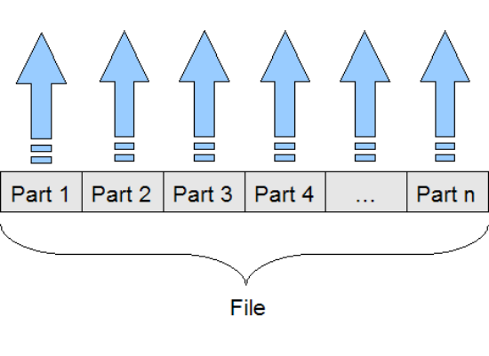
Multipart Upload
Upload large files in parts to improve throughput and reliability.
Parallelism: Upload multiple parts at once.
Resilience: If one part fails, only that part needs to be re-uploaded.
Requirement: Recommended for files > 100MB. Mandatory for files > 5GB.

Slide 21
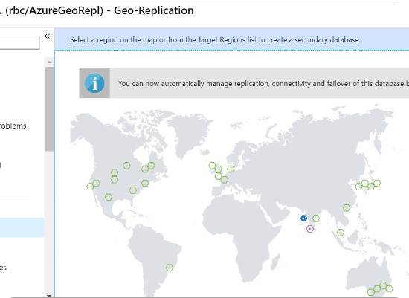
S3 Replication
CRR (Cross-Region)
Copies objects across buckets in different AWS Regions (e.g., US-East to EU-West).
SRR (Same-Region)
Copies objects across buckets in the same AWS Region.

Slide 22
Thank You!

